Slide 1
Effect of NH4Cl on synaptic transmission in crayfish neuromuscular junction
2015

Slide 2
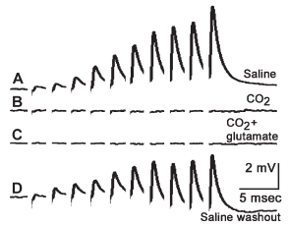
Crayfish NMJ
40 Hz stimulation
10 pulses
BTW
CO2 in saline
blocks transmission

Slide 5
The Na is reduced in saline to examine if the reduced Na so when
adding (60mM) NH4Cl with reduced Na +added NH4Cl (balance Osm) to ensure nerve was still
able to function with the reduced Na+ in the NH4Cl
Need to divide Amplitude by 10x

Slide 6
Need to divide Amplitude by 10x

Slide 7
Need to divide Amplitude by 10x

Slide 8
Effect of NH4Cl on synaptic transmission in Drosophila larvae neuromuscular junction
2012

Slide 9
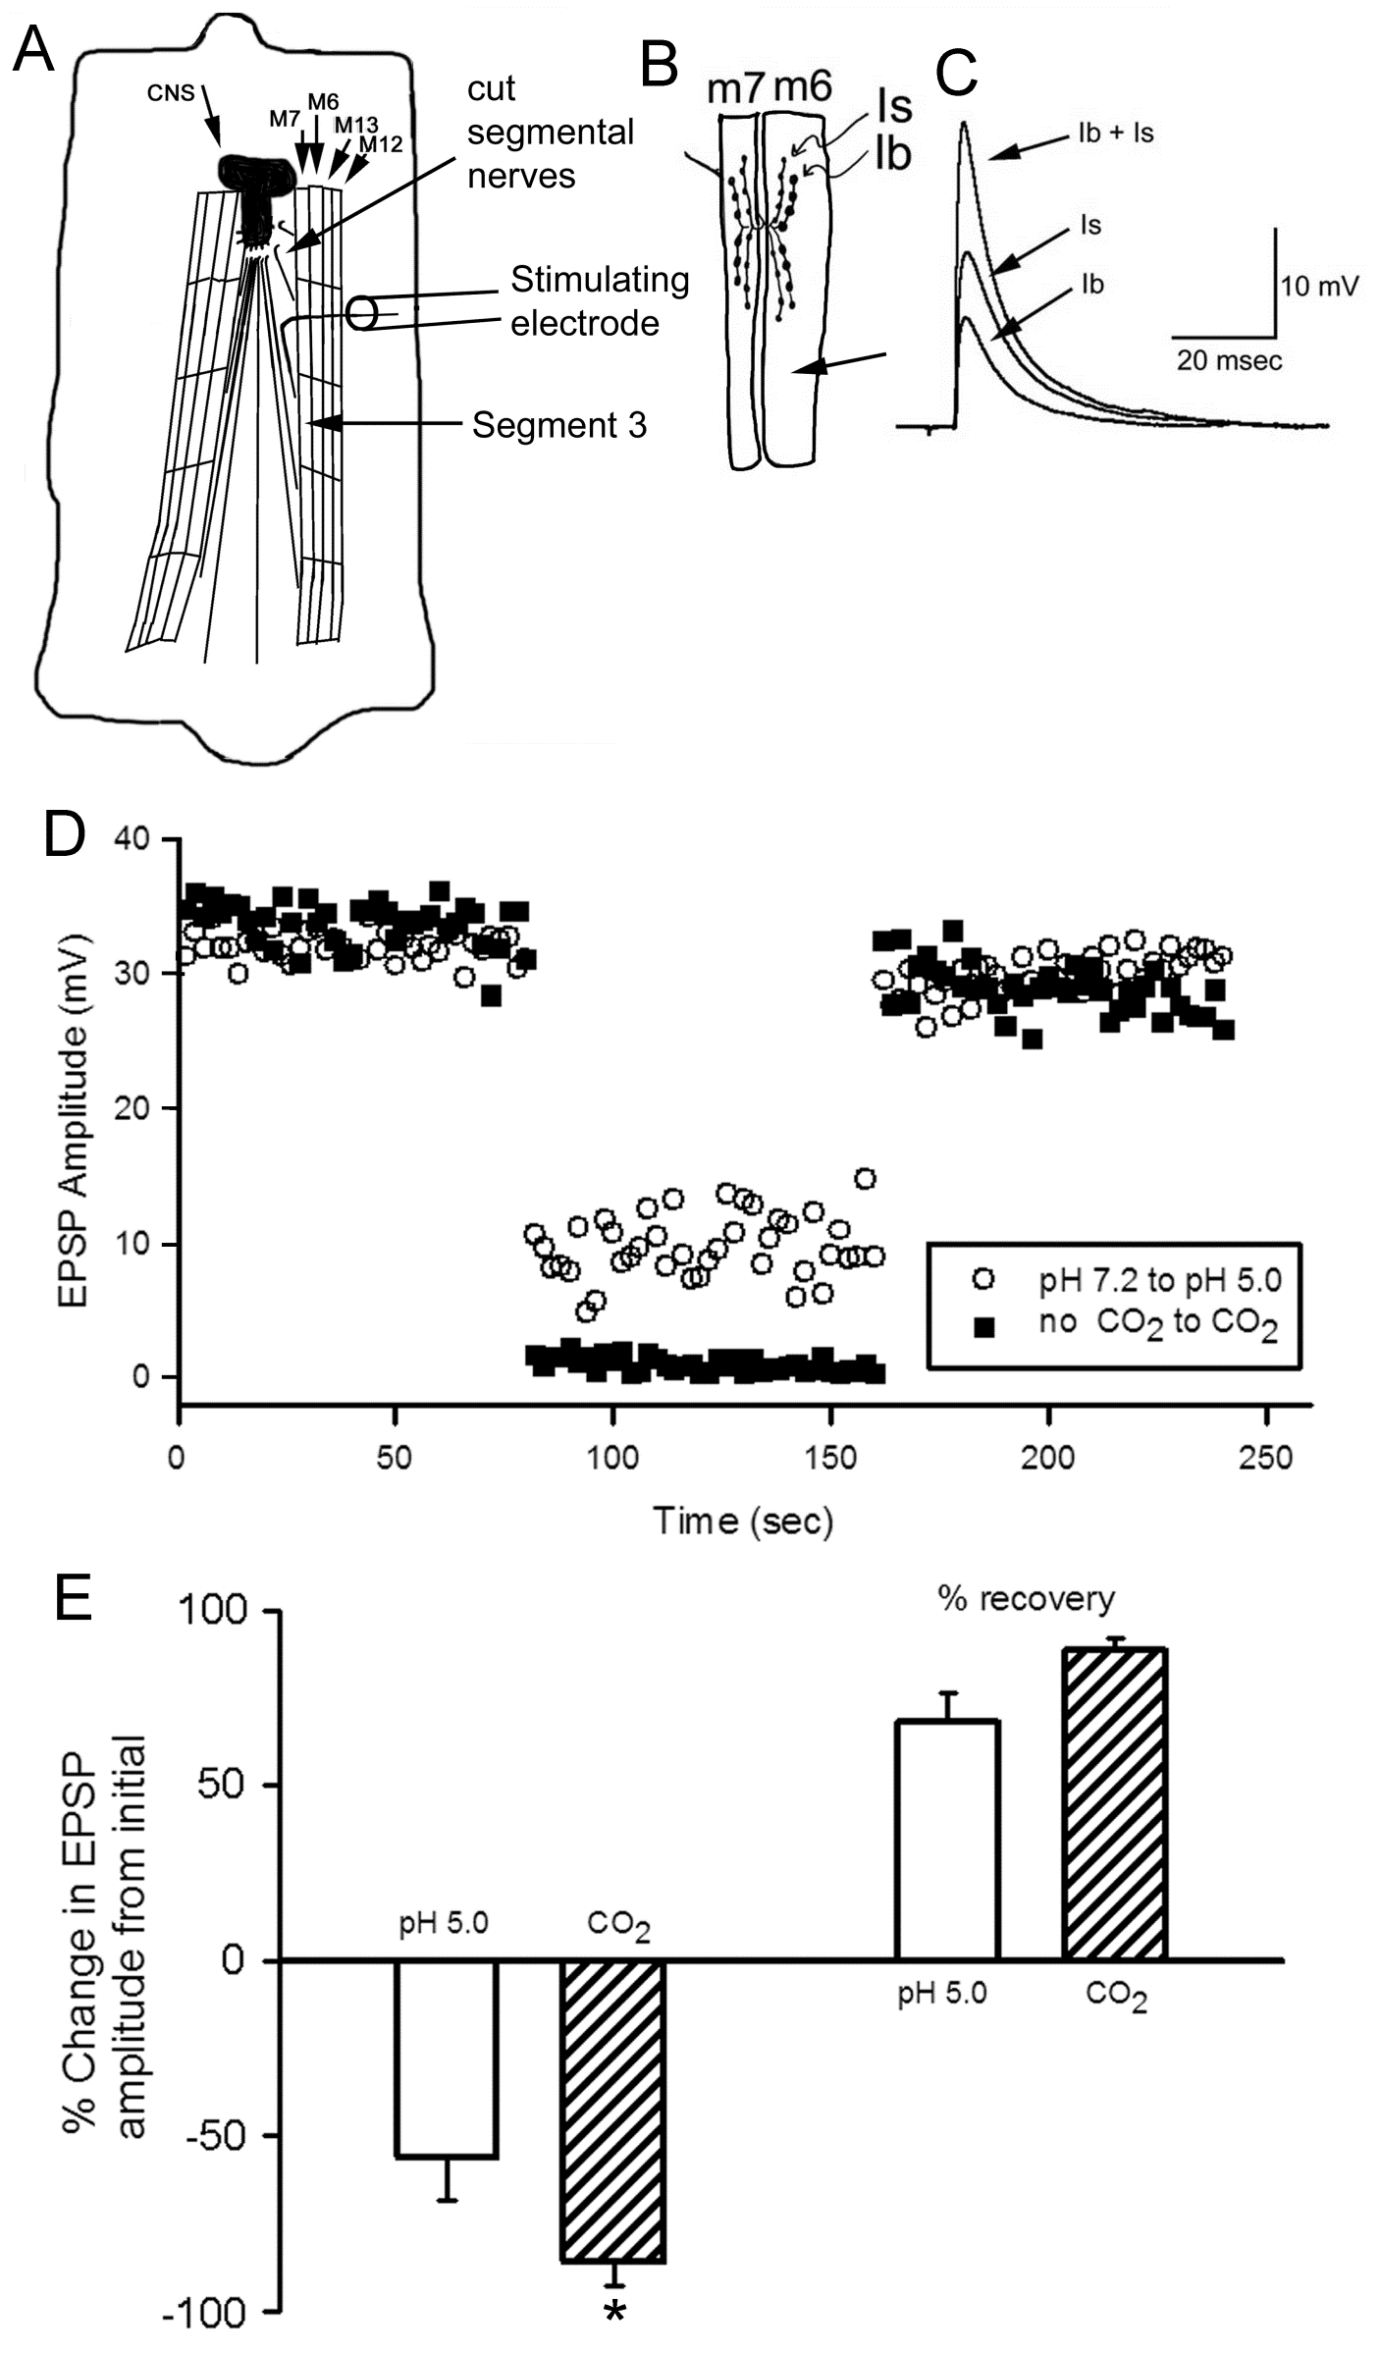
Stimulate and recruit both motor neurons
1 Hz stimulation rate

Slide 10
20mM ammonium chloride

Slide 12
The 20 mM NH4Cl has 70 mM NaCl so stays around the same OSM
But with fly NMJ in 20 mM the EPSP does not increase after wash out of NH4Cl

Slide 14
60mM ammonium chloride

